Slide 1
Driver Monitoring Using Deep Learning
Younsuk Choi

Slide 2
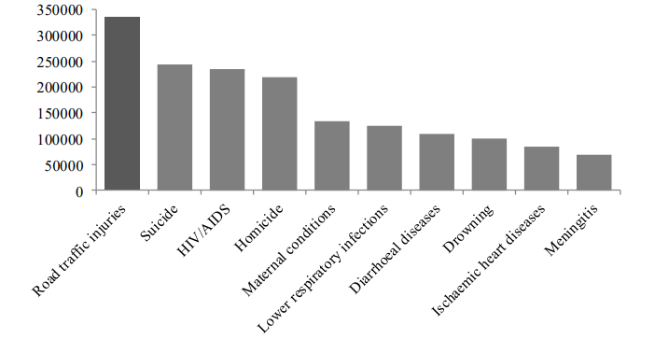
Motivation

Slide 3
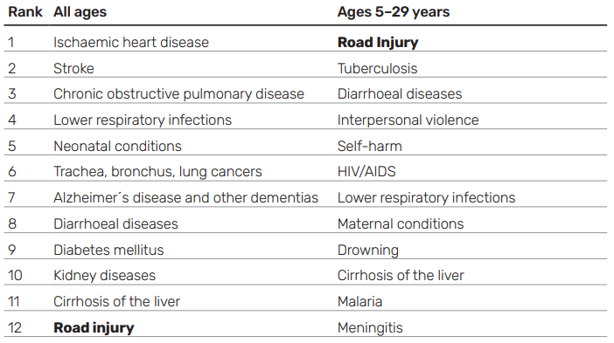
Motivation

Slide 4
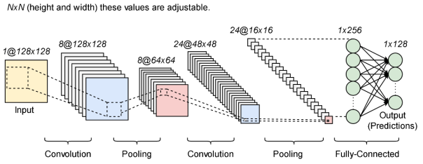
CNN

Slide 5
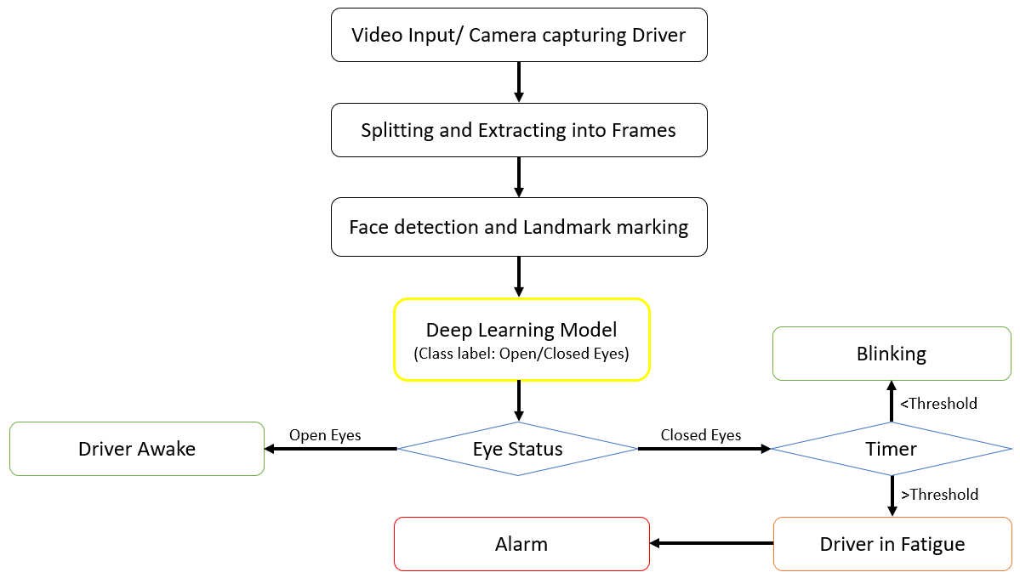
System Description

Slide 6
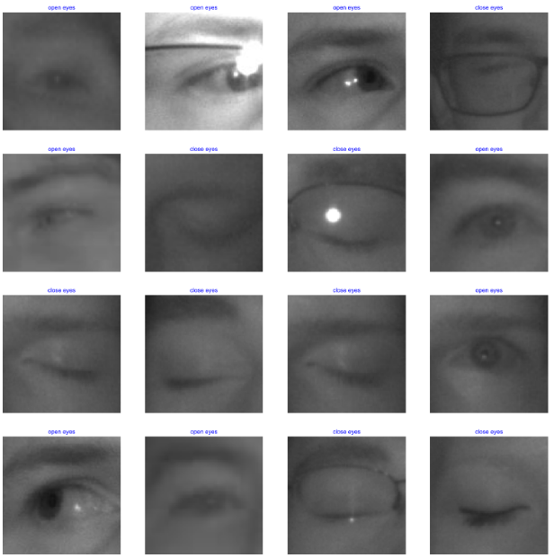
MRL Datasets

Slide 7
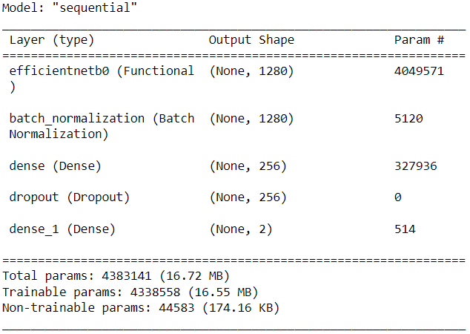
Implementation

Slide 8

Implementation

Slide 9
Implementation

Slide 10
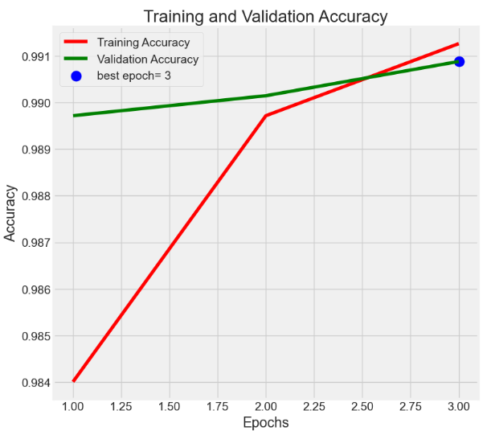
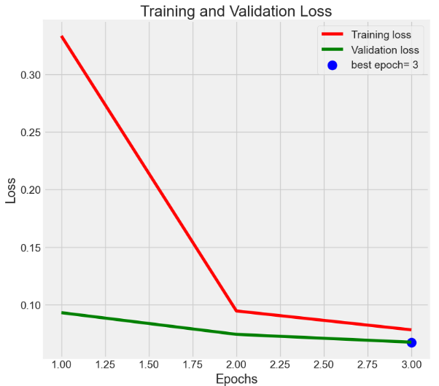
Results

Slide 11
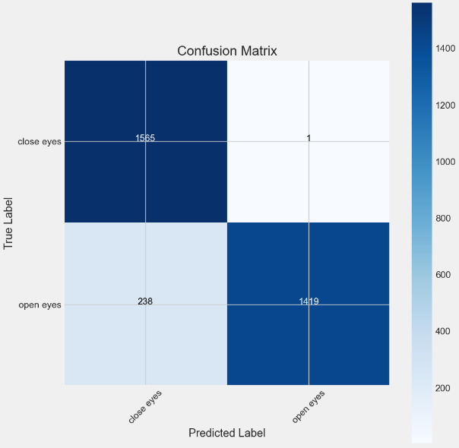

Results

